Slide 1

IT 353 Web Development Technologies
Jianwei Lai
jlai12@ilstu.edu
Notes:
http://www.w3schools.com/cssref/trysel.asp

Slide 2
Content
Background
Animations

Slide 3
Backgrounds

Slide 4
Backgrounds
background-color
background-image
background-repeat
background-attachment
background-position
https://www.w3schools.com/css/tryit.asp?filename=trycss_background-image_attachment
Notes:
The background-attachment property specifies whether the background image should scroll or be fixed
background-attachment: scroll;
Can you add a color background?
background-color: rgb(225,0,0, 0.2);
Can you have two images as the background?
background-image: url("img_tree.png"), url("img_tree.png");
background-position: right top, left top ;

Slide 5
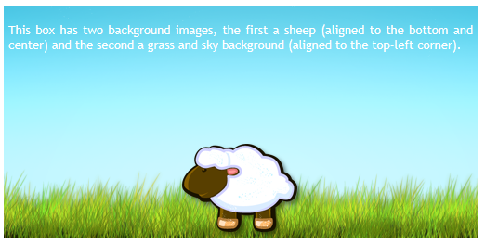
multiple Backgrounds
The new ability to use multiple backgrounds is a great time saver, allowing you to achieve effects which previously required more than one div.
#example1 { width: 500px; height: 250px; background-image: url(sheep.png), url(betweengrassandsky.png); background-position: center bottom, left top; background-repeat: no-repeat; }
Notes:
5

Slide 6
Animation

Slide 7
@keyframes
@keyframes
animation-name
animation-duration
animation-delay
animation-iteration-count
animation-direction
animation-timing-function
animation-fill-mode
animation
https://www.w3schools.com/css/tryit.asp?filename=trycss3_animation2
Notes:
animation-iteration-count: 2;
Infinite
Try animation-delay: -2s;

Slide 8
Make glowing stars with css
Step 1: Create a html file
<!DOCTYPE html>
<html>
<head>
<title>GLOWING STARS</title>
</head>
<body>
</body>
</html>
Notes:
Source: https://blog.csdn.net/immocha/article/details/103528593

Slide 9
Step 2: Add three div to add star pictures
<div class="container">
<div class="star star1"></div>
<div class="star star2"></div>
<div class="star star3"></div>
</div>

Slide 10
Step 3 Add css style
<link rel="stylesheet" href="starstyle.css">
Change the background to dark blue
Set width and height
Set animation glow
.star {
position : absolute;
width : 100%;
height : 600px;
}
body {
background-color: rgb(13,2,48);
}

Slide 11
Step 4: Add pictures as background
.star1 {
background: url(images/stars1.png) no-repeat center center;
}
.star2 {
background: url(images/stars2.png) no-repeat center center;
}
.star3 {
background: url(images/stars3.png) no-repeat center center;
}

Slide 12
Step 5: Define glow animation
Add animation glow to the star class
.star {
position : absolute;
width : 100%;
height : 600px;
animation: glow 2.s ease-in infinite;
}
@keyframes glow {
10% {
opacity: 0;
}
90% {
opacity: 1;
}
}
Notes:
Try adding more values, for example
40% {
opacity: 0.6;
}
70% {
opacity: 0.4;
}

Slide 13
Add delay
.star2 {
background: url(imagess/stars2.png) no-repeat center center;
animation-delay: 0.8s;
.star3 {
background: url(imagess/stars2.png) no-repeat center center;
animation-delay: 1.2s;
}
Notes:
<!DOCTYPE html>
<html>
<head>
<title>GLOWING STARS</title>
<link rel="stylesheet" href="starstyle.css">
</head>
<body>
<div class="container">
<div class="star star1"></div>
<div class="star star2"></div>
<div class="star star3"></div>
</div>
</body>
</html>
body {
background-color: rgb(13,2,48);
}
.star {
position : absolute;
width : 100%;
height : 600px;
animation: glow 2s ease-in infinite;
}
.star1 {
background: url(imagess/stars1.png) no-repeat center center;
}
.star2 {
background: url(imagess/stars2.png) no-repeat center center;
animation-delay: 0.5s;
}
}
.star3 {
background: url(imagess/stars3.png) no-repeat center center;
animation-delay: 1s;
}
@keyframes glow {
10% {
opacity: 0;
}
90% {
opacity: 1;
}
}
source：https://blog.csdn.net/immocha/article/details/103528593
source：https://blog.csdn.net/immocha/article/details/103528593

Slide 14
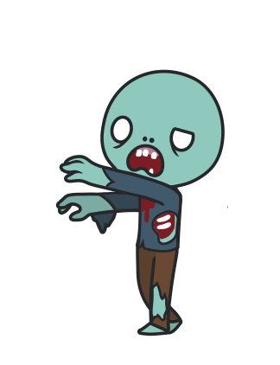
Practice 1: Create an animation
Create a zombie and let him walk across your screen
Due 9/8 next at 11:55pm

Slide 15
Step 1: create a html document
<!DOCTYPE html>
<html>
<head>
</head>
<body>
</body>
</html>

Slide 16
Step 2: Add a “title”
<!DOCTYPE html>
<html>
<head>
<title>Zombie</title>
</head>
<body>
</body>
</html>

Slide 17
Step 3: Add a “h1”
<!DOCTYPE html>
<html>
<head>
<title>Zombie</title>
</head>
<body>
<h1>This is a scary zombie</h1>
</body>
</html>

Slide 18
Step 4: Add a “id”
<!DOCTYPE html>
<html>
<head>
<title>Zombie</title>
</head>
<body>
<h1>This is a scary zoombie</h1>
<div id ="zombie"></div>
</body>
</html>

Slide 19
Step 5: Add a css file
<!DOCTYPE html
<html>
<head>
<title>Zombie</title>
<link rel="stylesheet" href="css/styles.css">
</head>
<body>
<h1>This is a scary zombie</h1>
<div id ="zombie"></div>
</body>
</html>

Slide 20
Step 6: Create a styles.css file
h1{
color:red;
font-style: italic;
}
You can try different colors and fonts

Slide 21
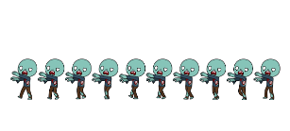
Step 7: add an image
#zombie {
/*Our png picture is 2000px * 312px, then each frame is 200px * 312px*/
width: 200px;
height: 312px;
background-image: url("../img/walkingdead.png");
}
Download the picture from Reggienet in the week 3 folder

Slide 22
Step 8: add animation
#zombie {
/*Our png picture is 2000px * 312px, then each frame is 200px * 312px*/
width: 200px;
height: 312px;
background-image: url("../img/walkingdead.png");
animation: plays 1.8s steps(10) infinite ; Change the time to see the difference!!! Remove the steps(10) to see the difference!!!
}
@keyframes plays {
from { background-position: 0px; }
to { background-position: -2000px; }
}

Slide 23
Step 9: move the zombie to the center
#zombie {
/*Our png picture is 2000px * 312px, then each frame is 200px * 312px*/
width: 200px;
height: 312px;
background-image: url("../img/walkingdead.png");
animation: plays 1.8s steps(10) infinite ;
margin:auto;
}

Slide 24
Challenge 1: make him walk across the screen
Put the “zombie” div in another div.
<div id="wrapper">
<div id ="zombie"></div>
</div>"
#wrapper{
width: 600px;
height: 200px;
position: relative;
animation: move 4s infinite ;
}
@keyframes move {
0% {left:500px; top:0px;}
25% {left:400px; top:0px;}
50% {left:300px; top:0px;}
75% {left:200px; top:0px;}
100% {left:100px; top:0px;}
}

Slide 25
Challenge 2: make him jump while walking
@keyframes move {
0% {left:500px; top:0px;}
25% {left:400px; top:50px;}
50% {left:300px; top:50px;}
75% {left:200px; top:0px;}
100% {left:100px; top:50px;}
}

Slide 26
Challenge 3: make the zombie flash
@keyframes move {
0% {left:500px; top:0px; opacity: 1;}
25% {left:400px; top:50px; opacity: 0.1;}
50% {left:300px; top:50px;opacity: 1;}
75% {left:200px; top:0px;opacity: 0.1;}
100% {left:100px; top:50px; opacity: 1;}
}

Slide 27
Add the following to both animations
animation-direction: alternate;

Slide 28
Zip all the files and submit to Reggienet by 9/8

Slide 29
Assignments
Assignment 1 due 9/1 11:55pm
Practice 1 due 9/8 11:55pm

Slide 30
Before next class
Read CSS tutorial
Start read JavaScript tutorial https://www.w3schools.com/js/default.asp
Assignment 1 due today

